Slide 1

Early warning system ML Project @ironhack by Anastasia samoylova

Slide 2
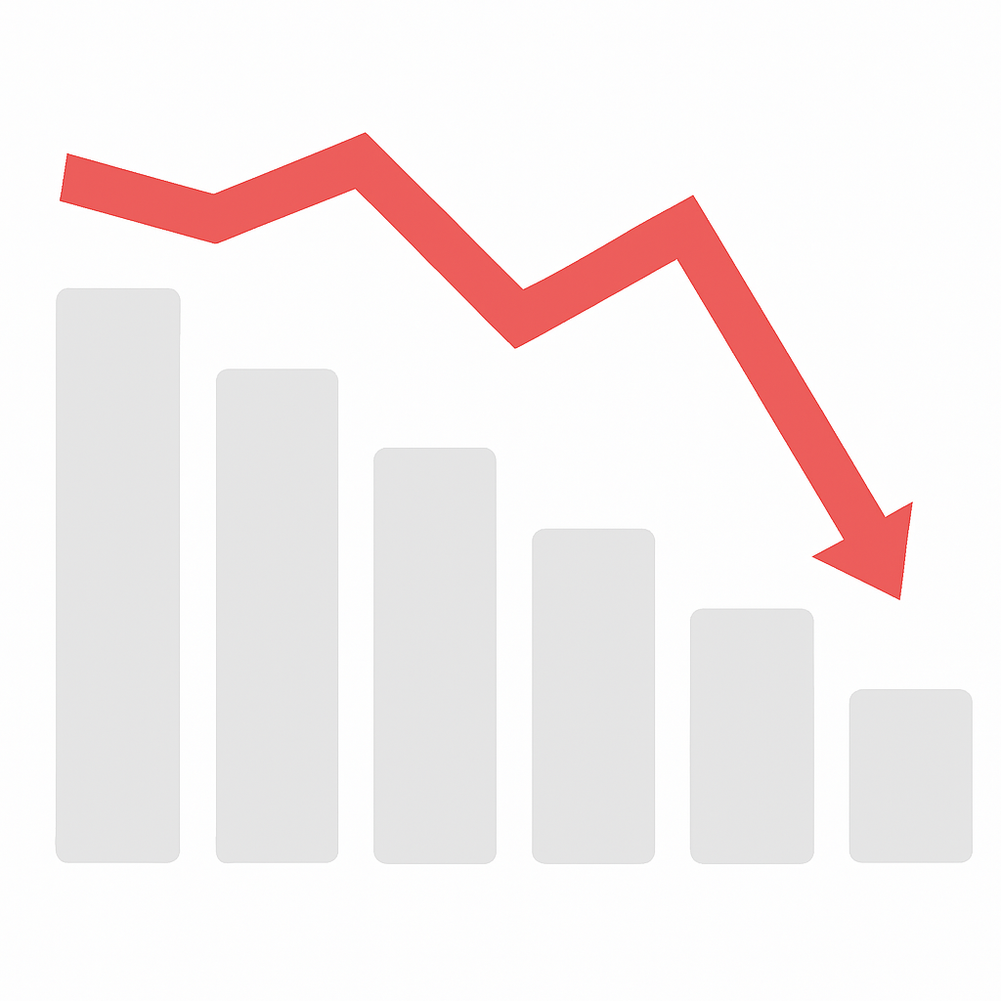
Company X Project
Company Branch: manufacturer of medical devices
Scope & Objective
Use real company sales data
Detect downward trends that need attention
Develop an early warning system to identify products at risk
Business Value
Proactive sales and marketing action
Better forecast accuracy
Inventory optimization

Slide 3
Process approach
Data Preparation
Gather and preprocess company data
Modeling
Train model on risk factors
Reporting
Build informative and interactive dashboard (PBI)
Engineer risk features
Predict risk for the next month

Slide 4
Project DATA SCOPe
Project scope (Priority 1)
Only internal ERP data
Data from 2022 Jan – 2025 Apr
Future enhancement (Priority 2)
Integrate CRM data
Integrate external data
→ e.g. Google Analytics metrics could help indicate pre-sales user interest and engagement trends
PRIORITY | DATA FIELD | SOURCE
1 | Date (Transactional Date in Format MMYYYY) | ERP
1 | Units_sold | ERP
1 | Product_ID | ERP
1 | Product_Category | ERP
1 | Product_Line | ERP
1 | Customer_ID | ERP
2 | Sales_Rep_Activity | CRM
2 | Active_users | Web Analytics Platform
2 | Items_views | Web Analytics Platform
2 | Engaged_sessions | Web Analytics Platform
… | … | …

Slide 5
Data preparation – risk features
These features serve as the foundation for predicting product risks
FEATURE | WHY IT MATTERS | HOW IT’S CALCULATED
Calendarization Factors | allows normalization of sales by calendarization | For each month Y of year X: Total units sold in Y per product category / Total units sold in X per product category
Normalized Units | Neutralizes calendar effects (month lengths, holidays) Allows fair comparisons across products and time | CM units sold divided by calendarization factor, then normalized by calendarized avg units per product year
# Unique Customers | Allows tracking of customer engagement | Distinct count of customers per product, month and year
MoM Growth % | Measures monthly fluctuations in product performance and customer engagement | (CM - LM) / LM
Deviation from Trend % | Detects if the latest point is under- or over-performing relative to recent trend | Difference between CM and predicted (linear trend) values / predicted CM
Volatility | High volatility indicates instability in sales, which can be a sign of product risk | Rolling std dev / rolling mean over 4 months
Consecutive Drop | Signal of sustained downward trend | Binary flag if units declined in 4 consecutive months
Negative Trend Streak | Signal of sustained downward predicted trend | Counts how many months in a row have had a negative trend

Slide 6
Data preparation – target features
5 Risk Target Features = Risk Factors
and 1 Meta Risk = combination of risk factors
All risk factors were shifted 1 month backward to predict next month risk
TARGET FEATURE | THRESHOLD LOGIC / RULE
Volatility | Binary flag if Volatility > 0.3
Under Trend Prod | Binary flag if Product 'Vs_trend_pct' < -0.35
Under Trend Cust | Binary flag if Customer 'Vs_trend_pct-cust' < -0.35
Negative Trend | Binary flag if 'Neg_Trend_Streak' > 2
Consecutive Drop | Binary flag if 'Consec_Drop’ = 1
Risk Target Meta | Meta Risk Level increases with the number of triggered risk factors: If 4 or more risk factors are TRUE → Meta Risk = 2 If 2 or 3 risk factors are TRUE → Meta Risk = 1 Else → Meta Risk = 0

Slide 7
Modeling pipeline – risk factors and meta risk
Model Goal: Predict next month’s risk level (Low, Medium, High)
Approach: Train each risk factor individually and combine them in a meta-model
For all target features labels and probabilities were predicted
RISK CLASS | FEATURE | ALGORITHM | DESCRIPTION
Risk Factor | Volatility | GradientBoostingClassifier | Relative variability of sales in last 4 months
Risk Factor | UnderTrend_Prod | GradientBoostingClassifier | CM vs linear trend based on last 4 months
Risk Factor | UnderTrend_Cust | GradientBoostingClassifier | CM unique customers per product ID vs linear trend based on last 4 months
Risk Factor | NegTrend | GradientBoostingClassifier | Binary Months that product has had a consecutive negative trend. 1 if > 2
Risk Factor | ConsDrop | GradientBoostingClassifier | Consecutive decline in sales within last 4 months
Risk Meta | Next_Month_Risk | XGBClassifier | Modeling using risk features

Slide 8
Final Risk Label Assignment –
Early Warning System
Combining Meta Risk with a calculated weighted Risk Score:
WEIGHTED RISK SCORE % is the average predicted probability across individual risk factor models, weighted by their feature importance
final META RISK LEVEL
If Meta Risk = 2 and Weighted Risk Score > 65% → High Risk (2)
Else if Meta Risk = 1 and Weighted Risk Score > 40% → Medium Risk (1)
Else → Low Risk (0)
→ Dashboard

Slide 9

THANK YOU

Slide 10
BACK UP

Slide 11
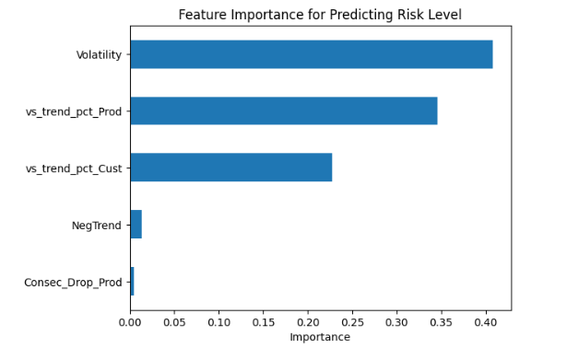
FEATURE IMPORTANCE

